Slide 1
DBMS Project : Hotel Management
Snavya Sai MB ENG19CS0312 Tejaal M ENG19CS0334
Varsha Premanand ENG19CS0353

Slide 2
Introduction
In our project “Hotel Management System” we have tried to show how the data/information in hotels is managed. This is just an overview of management in hotels. This system manages and maintains the records of customers, rooms, employees and drivers in the hotel. The project is aimed to maintain the day-to-day state of admission/vacation of Residents, List of employees, room details etc. Main objective of this project is to provide a solution for hotels to manage most their work using computerized processes.
This software application will help admin to handle customer information, room allocation details, Payment details etc.
The rooms have different categories like single bed, double bed etc. so their charges and records will be maintained accordingly.
This software has been made in a user friendly interface, so that anyone can add, delete, update the entries and handle all the transactions This software has been made in a user friendly interface, so that anyone can add, delete, update the entries and handle all the transactions easily. For security purposes we have provided admin username and password.
The project, Hotel Management System is a desktop-based application that allows the hotel manager to handle all hotel activities online. Interactive GUI and the ability to manage various rooms, employees, drivers and customers make this system very flexible and convenient. This application gives managers the power and flexibility to manage the entire system from a single online system. Hotel management project provides room booking, staff management and other necessary hotel management features. The system allows the manager to post available rooms in the system.

Slide 3
Problem Statement
To create a Hotel Managenmrnt System,that manages and maintains the records of customers, rooms, employees and drivers in the hotel. The project is aimed to maintain the day-to-day state of admission/vacation of Residents, List of employees, room details etc.

Slide 4
Objective
Main objective of this project is to provide a solution for hotels to manage most their work using computerized processes. This software application will help admin to handle customer information, room allocation details, Payment details etc.

Slide 5
Features
Hotel Room Bookings and Reservation
Front Desk Operations
Managing Guest Profile
User Privilege and security control
Keeping a tab on guest check-in check-out status
Maintenance of hotel rooms.
Providing a user friendly interface.

Slide 6
User Requirements
There should be software which allocates rooms automatically and maintains records of customers.

Slide 7
System Requirements
There should be a database backup of the hotel management system. There should be a Java supported framework for the system. Operating system should be WindowsXP or a higher version of windows.
User Interface
The User interface required to be developed for the system should be user friendly and attractive.
There are two sets of java APIs for graphics programming:
AWT (Abstract Windowing Toolkit) and Swing.
AWT API was introduced in JDK 1.0. Most of the AWT components have become obsolete and should be replaced by newer Swing components.

Slide 8
System Requirements
Swing API, a much more comprehensive set of graphics libraries that enhances the AWT, was introduced as part of Java Foundation Classes (JFC) after the release of JDK 1.1. JFC consists of Swing, Java2D, Accessibility, Internationalization, and Pluggable Look-and-Feel Support APIs. JFC was an add-on to JDK 1.1 but has been integrated into core Java since JDK 1.2.
For the development of this project both hardware and software were required. The hard required is any machine compatible for running the softwares and resources required.

Slide 9
Software Requirements
Operating System Windows 10
Front End Java, NetBeans
Back End MySQL
Hardware Requirements
Desktop PC or a Laptop
Printer
Operating System – Windows 10
Intel®️ CoreTM i3-6006U CPU @ 2.00GHz
4.00 GB RAM
64-bit operating system, x64 based processor
1024 x 768 monitor resolution
Keyboard and Mouse

Slide 10
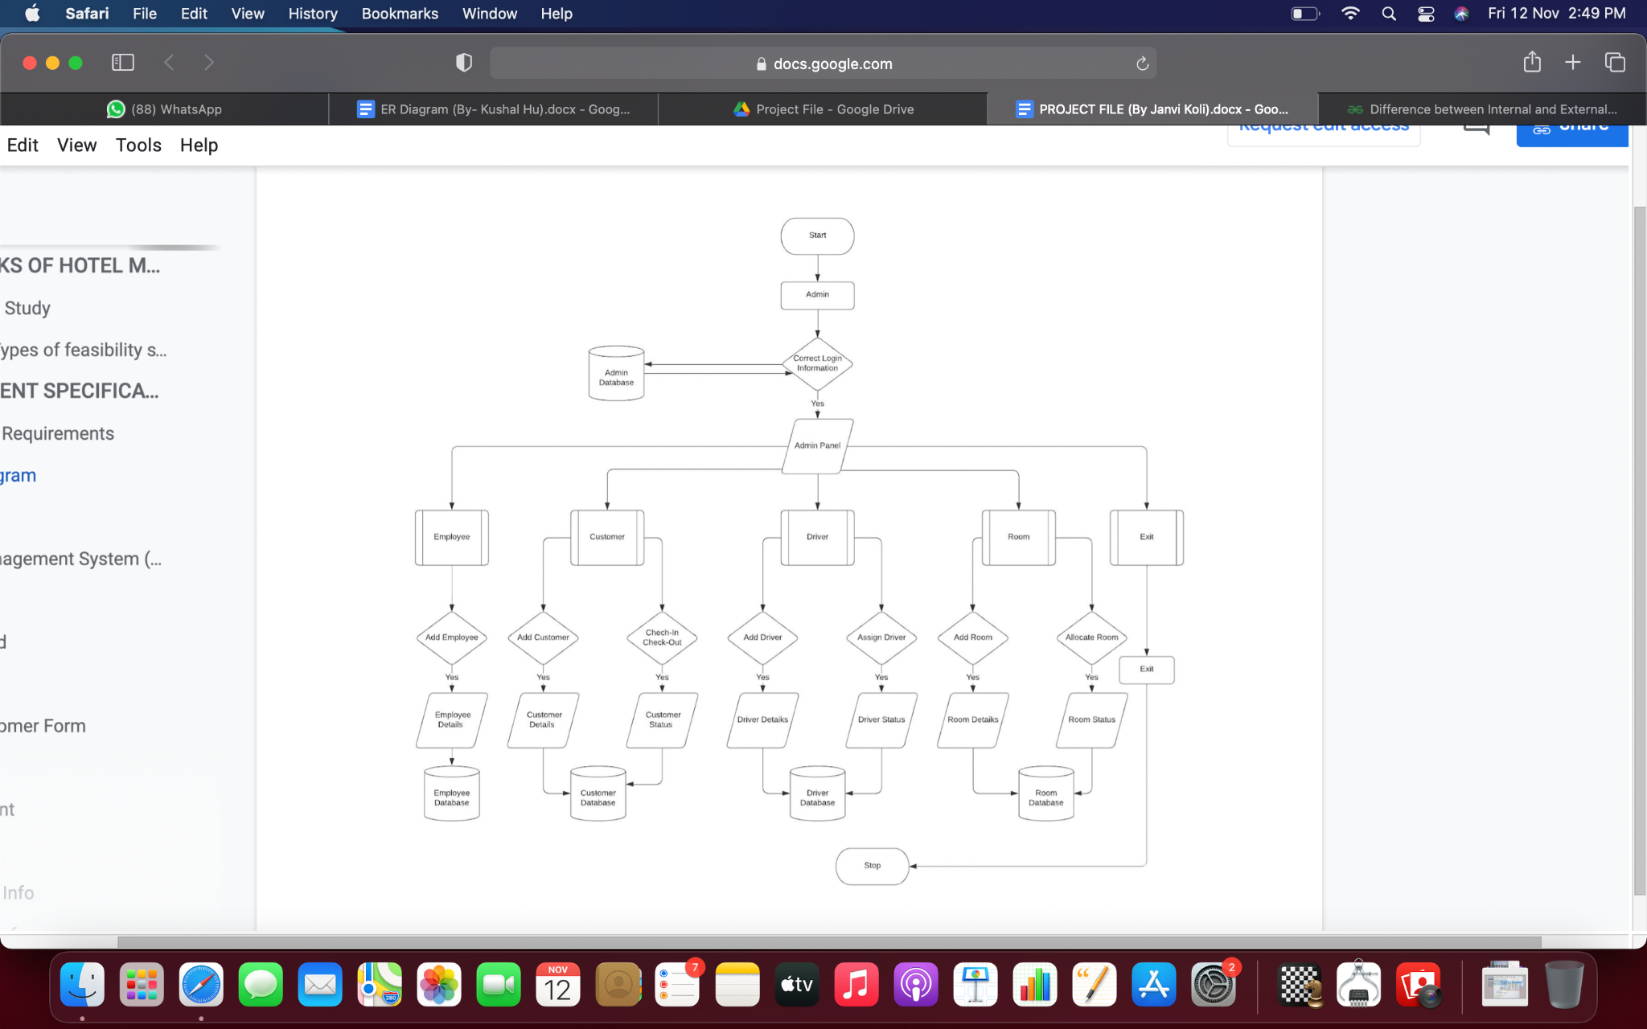
Class Diagram

Slide 11
Entities
customer
department
employee
login
room
driver

Slide 12
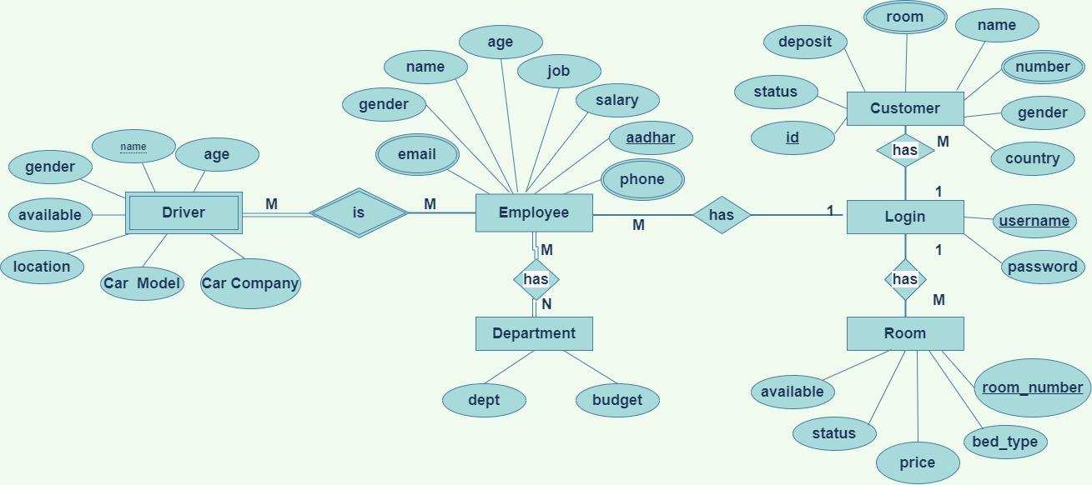
ER Diagram

Slide 13
System
Implementation

Slide 14
Module Description
1. Start
2. Create a
3. Create the main class named as HotelManagementSystem that extends JFrame
implements ActionListener and add buttons login.
4. Create a database in Mysql name projecthms.
5. Import the following files -
import java.awt.*;
import javax.swing.*;
import java.awt.event.*;
import net.proteanit.sql.DbUtils;
import java.sql.*;
6. Create a Login class that extends JFrame, add text label and password label to the
JFrame and two-button Login.
7. Enter the user name “admin” and password “password” to click the login button to
confirm access.

Slide 15
8. Create a class connection(conn) and declare a variable c with data type Connection. This
creates a connection by using “com.mysql.jdbc.Driver" .Connect the code
with database using Driver Manger using the following string
"jdbc:mysql://localhost/projecthms","root","password";
9. Create a class Dashboard that extends JFrame, Add the following buttons to the
JFrame , HOTEL MANAGEMENT and ADMIN, where HOTEL MANAGEMENT button has RECEPTION item and ADMIN button has items ADD EMPLOYEE, ADD ROOMS, ADD DRIVER.
10. ADD EMPLOYEE calls AddEmployee class, ADD ROOMS calls AddRoom class and ADD DRIVER calls AddDriver.
11. Now create AddEmployee Class that contains input fields where the employee data
can be given as an input and then using a button submit stores the data of the
employee in the MySQL database in table called “employee” using JDBC connect.
Same thing for the AddRoom, the input details of the room will be stored in the
MySQL database in the table “room” using JDBC connect, inside the ActionPerformed block.
12. Once the valid details are entered the button submit, stores the details in the database
and returns to the previous class Frame or by clicking Back, it will return to the
previous class file.

Slide 16
13. HOTEL MANAGEMENT button in the main menu - the action performed by this
button will lead to the Reception class where, New customer form , room, all employee
info, customer info, manager info, checkout, update check status, update room
status and main menu buttons exist. using these buttons will lead to respective class
file.
14. Now New Customer Form button will lead to Customer form class where the details
of a new customer can be added and then step 12 will be performed.
15. Now Room button will lead to room class file that will display all the rooms in the
form of a table and the button Load data will refresh if any changes are updated in
the database. And the button Back will take back to the reception screen.
16. Now all employee info button will lead to employee info class file that will display all
the employees in the form of a table and the button Load data will refresh if any
changes are updated in the database. And the button Back will take back to the
reception screen.
17. Now Customer info button will lead to employee info class file that will display all the
customers in the form of a table and the button Load data will refresh if any changes
are updated in the database. And the button Back will take back to the reception
screen.
18. Now manager info button will lead to employee info class file that will display all the
managers in the form of a table and the button Load data will refresh if any changes
are updated in the database and the button Back will take back to the reception
screen

Slide 17
19. The Check out button will lead to check out class where there exists a choice box
which displays all the checked in customer id’s and once selected there’s an image
button that will show the corresponding room number in the below text field. With
help of the button Check Out, once action is performed the details of the customers
will be removed from the checked in table and then the room will be available for other
customers. And reception class will be visible. Or with the Back button, the action
can take back to the reception frame.
20. The Update Check status button will lead to checkin class where there exists a choice
box which displays all the checked in customer id’s and once selected there is a
check button that will show the corresponding details of the customer in the below
text fields. And the amount paid and the pending amount can be seen and adjusted
here. Once everything is done the button update will update the details in the
database and will return to the reception frame. Or with the Back button, the action
can take back to the reception frame.
21. The Update room status button will lead to room class where there exists a choice box
which displays all the checked in customer id’s and once selected there’s a check
button that will show the corresponding details of the customer in the below text
fields. The room cleaning status and the availability can be seen and adjusted
here. Once everything is done the button update will update the details in the
database and will return to the reception frame. Or with the Back button, the action
can take back to the reception frame.
22. Finally, there exists a button Main Menu, the action performed by this will take back
to the main menu frame.

Slide 18
Important Code
Connection
package hotel.management.system;
import java.sql.*;
public class conn {
//interface declaration
Connection c;
Statement s;
//constructor
public conn(){
try{
Class.forName("com.mysql.jdbc.Driver"); //Registering the driver
c = DriverManager.getConnection("jdbc:mysql:///projecthms","root","Snavzz030901$$"); //Establishing connection
s = c.createStatement(); //creating a statement
}
catch(Exception e){
System.out.println(e);
}
}
}

Slide 19
Hotel Management System(Home Page)
package hotel.management.system;
import java.awt.*;
import javax.swing.*;
import java.awt.event.*;
public class HotelManagementSystem extends JFrame implements ActionListener{
//constructor
HotelManagementSystem(){
setBounds(300,150,800,430);
ImageIcon i1 = new ImageIcon(ClassLoader.getSystemResource("hotel/management/system/icons/first.jpg"));
JLabel l1 = new JLabel(i1);
setLayout(null);
l1.setBounds(0,0,800,430);
add(l1);

Slide 20
JLabel l2 = new JLabel("Hotel Management System");
l2.setBounds(20,0,1000,90);
l2.setForeground(Color.DARK_GRAY);
l2.setFont(new Font("serif",Font.PLAIN,70));
l1.add(l2);
JButton b1 = new JButton("Next");
b1.setBounds(680,360,100,20);
b1.setBackground(Color.LIGHT_GRAY);
b1.setForeground(Color.BLACK);
l1.add(b1);
b1.addActionListener(this);
setVisible(true);
while(true){
l2.setVisible(false);
try{
Thread.sleep(500);
}catch(Exception e){}
l2.setVisible(true);

Slide 21
try{
Thread.sleep(500);
}catch(Exception e){}
}
}
public void actionPerformed(ActionEvent ae){
new Login().setVisible(true);
this.setVisible(false); //closes the first frame once you click on next
}
public static void main(String[] args){
new HotelManagementSystem();
}
}

Slide 22
Output Screenshots

Slide 23
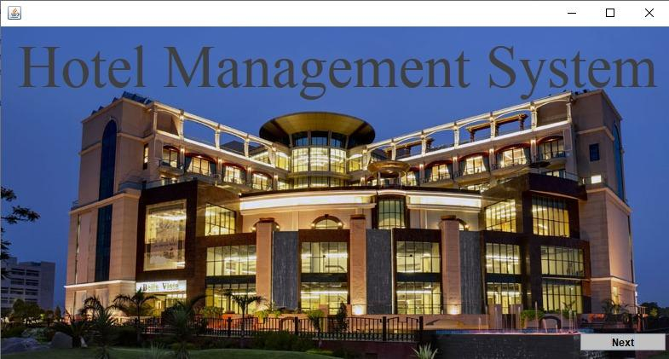
Home Page

Slide 24
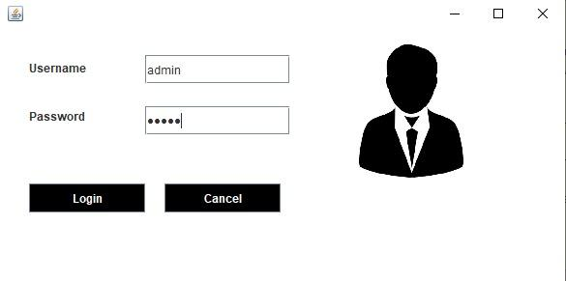
Login

Slide 25
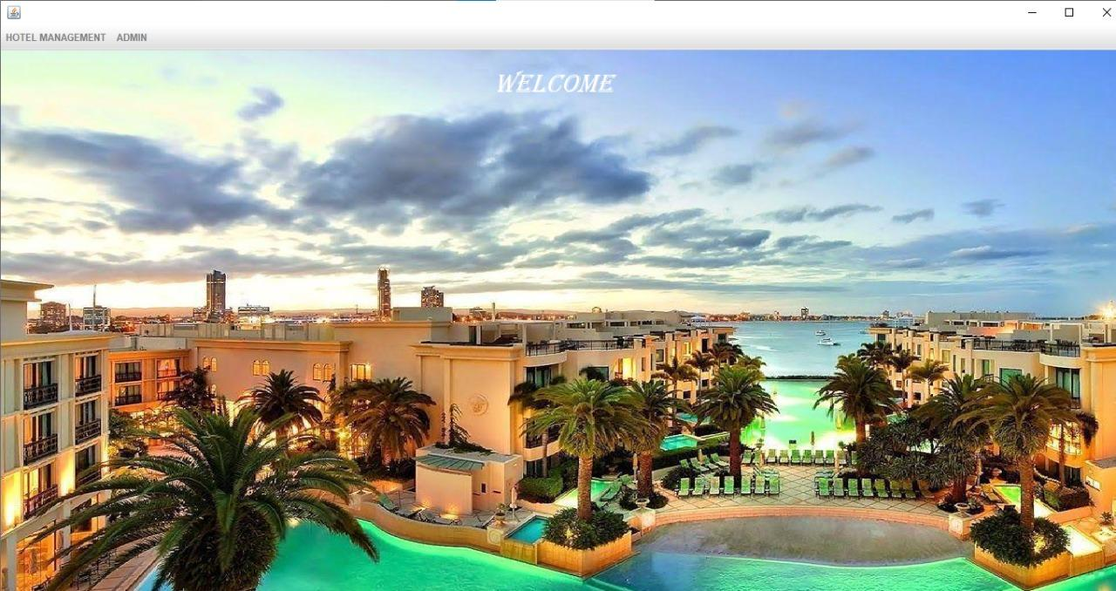
Dashboard

Slide 26
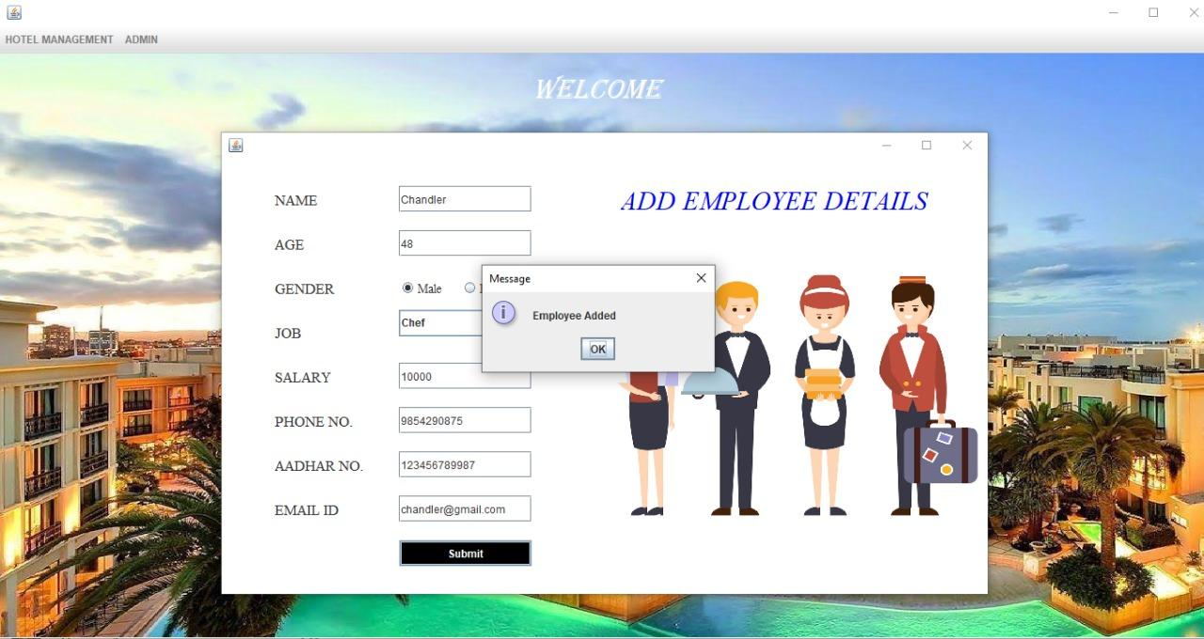
Add Employee

Slide 27
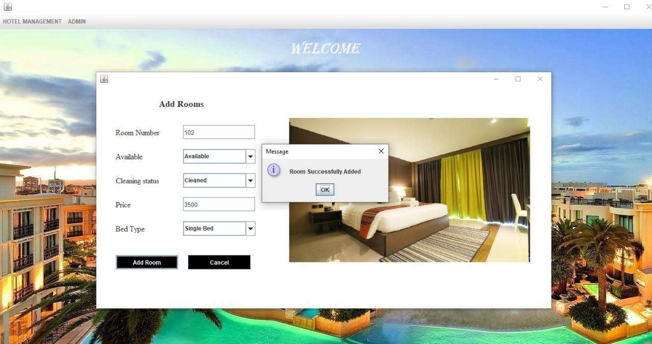
Add Room

Slide 28
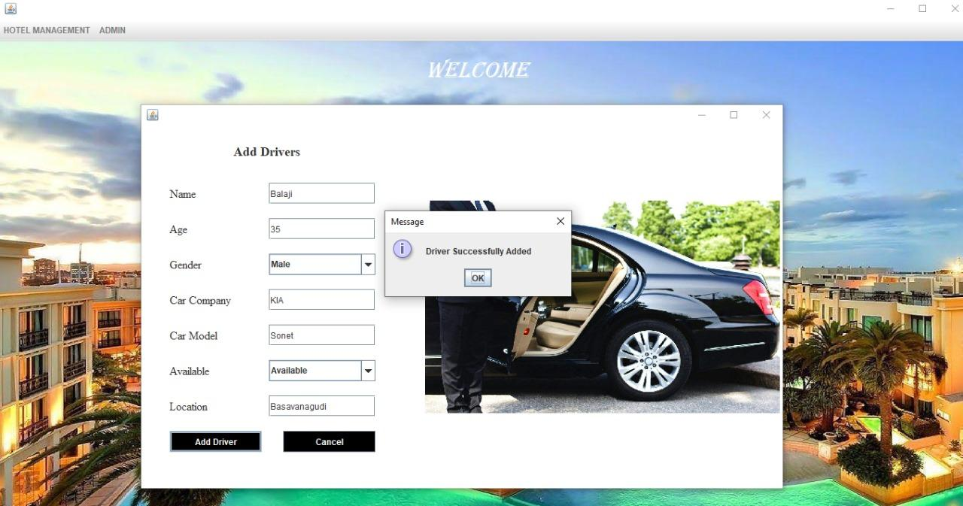
Add Driver

Slide 29
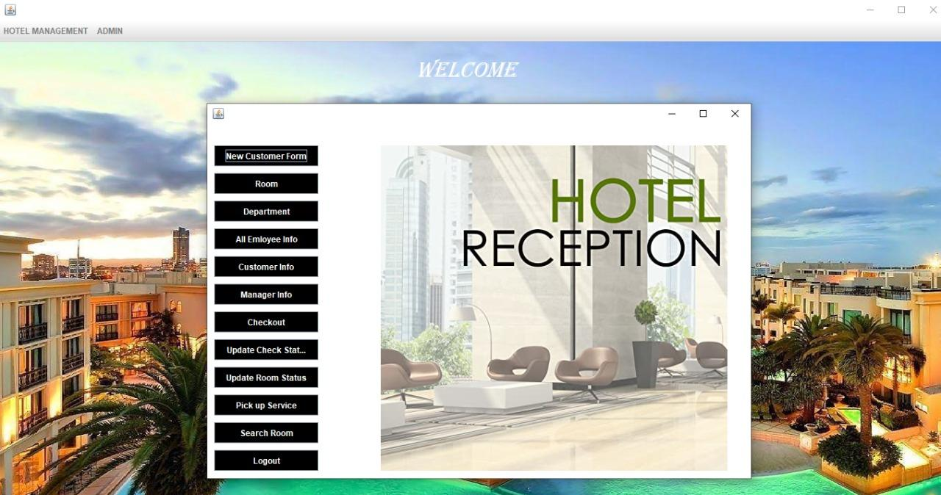
Reception

Slide 30
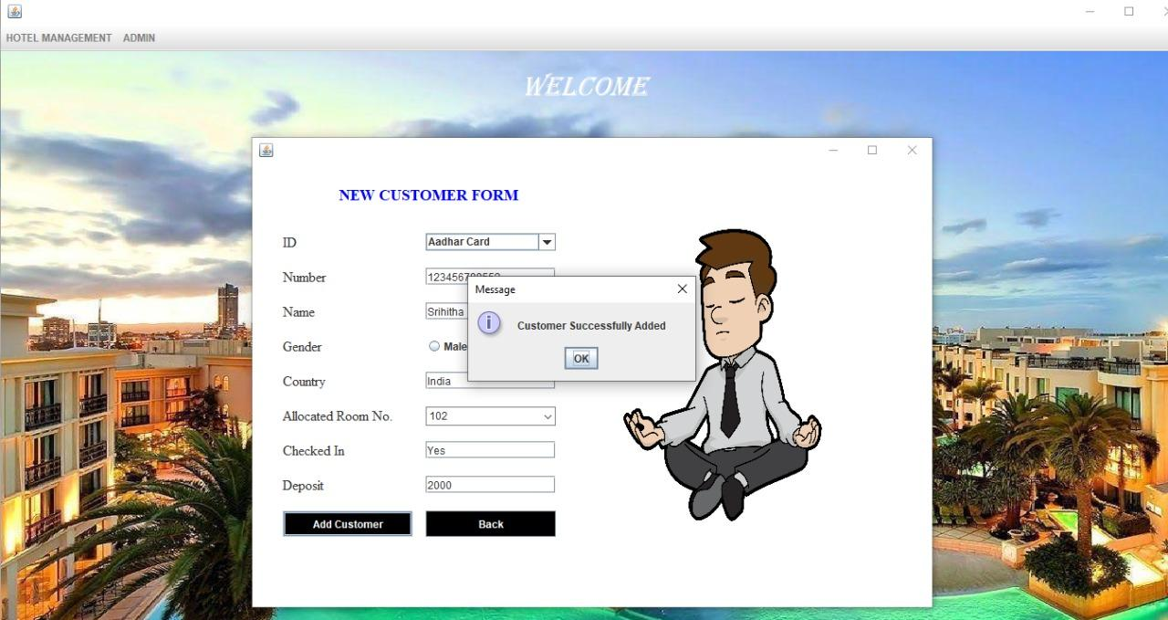
Add Customer

Slide 31
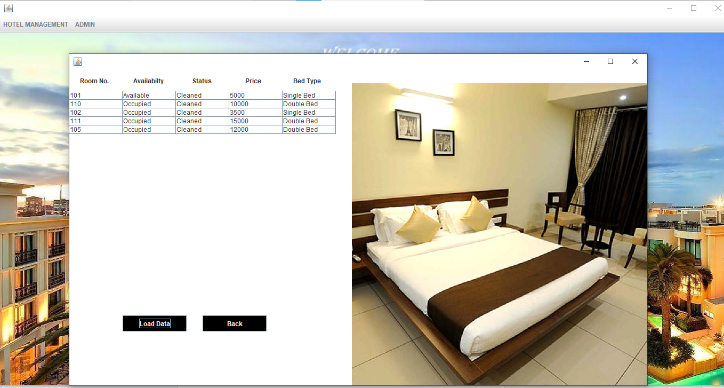
Room Details

Slide 32
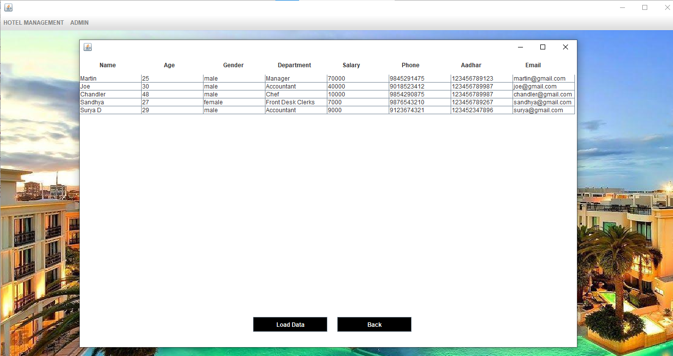
Employee Details

Slide 33
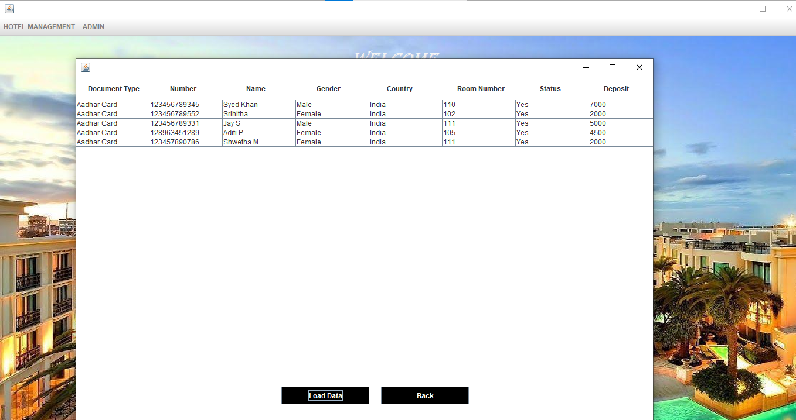
Customer Information

Slide 34
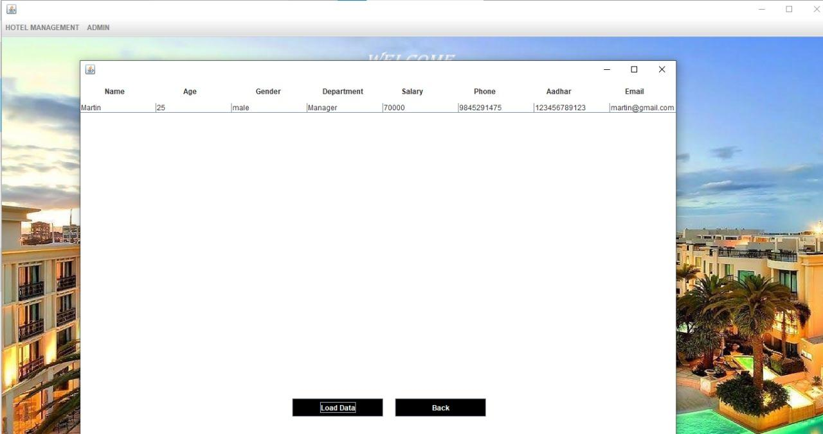
Manager Information

Slide 35
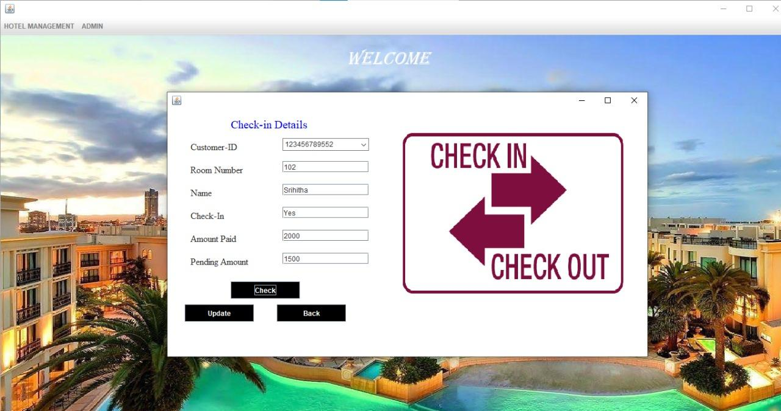
Check in Details

Slide 36
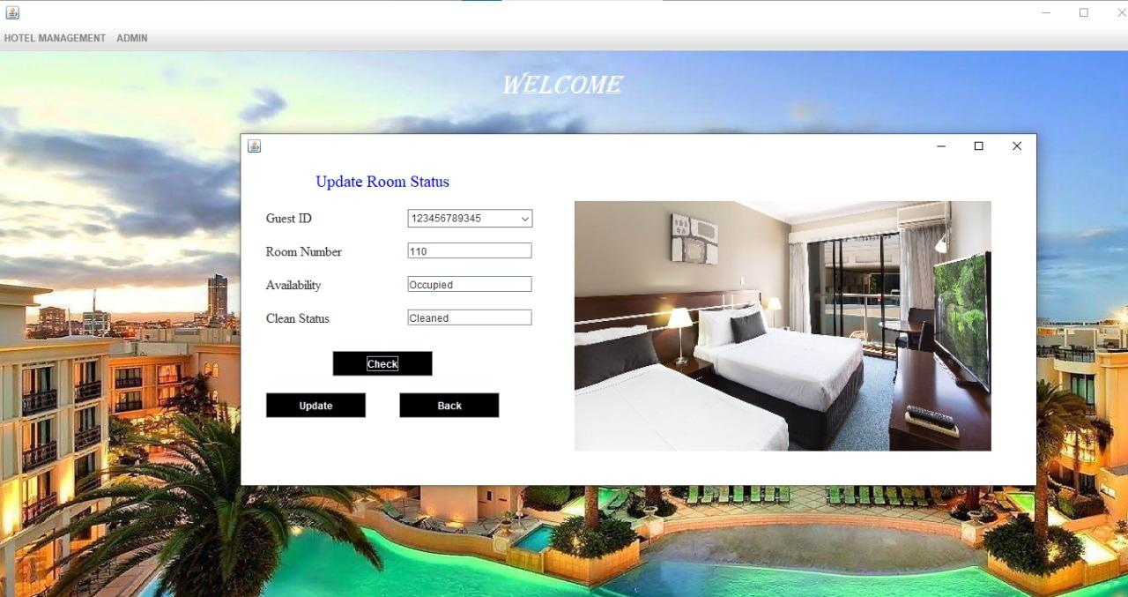
Room Status

Slide 37
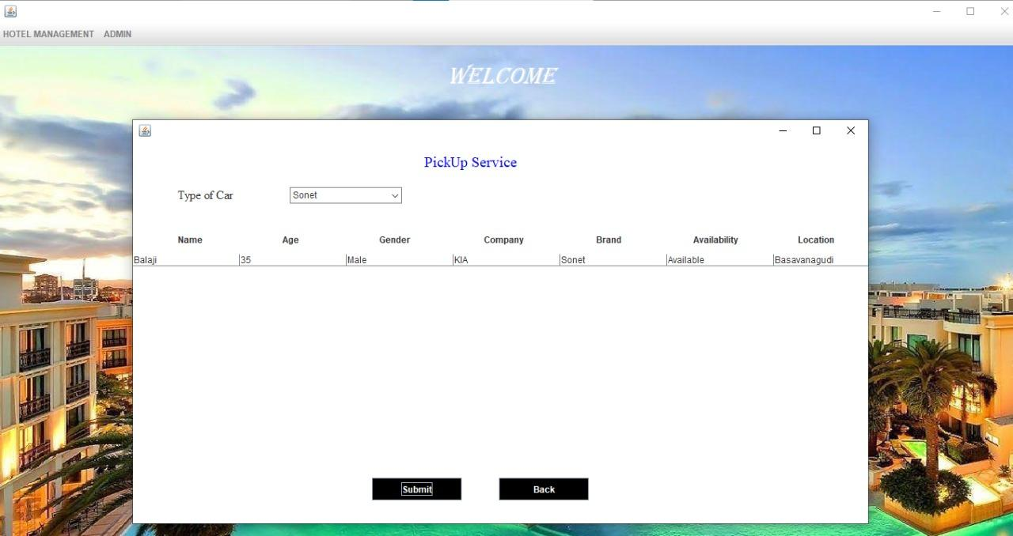
Pick up Service

Slide 38
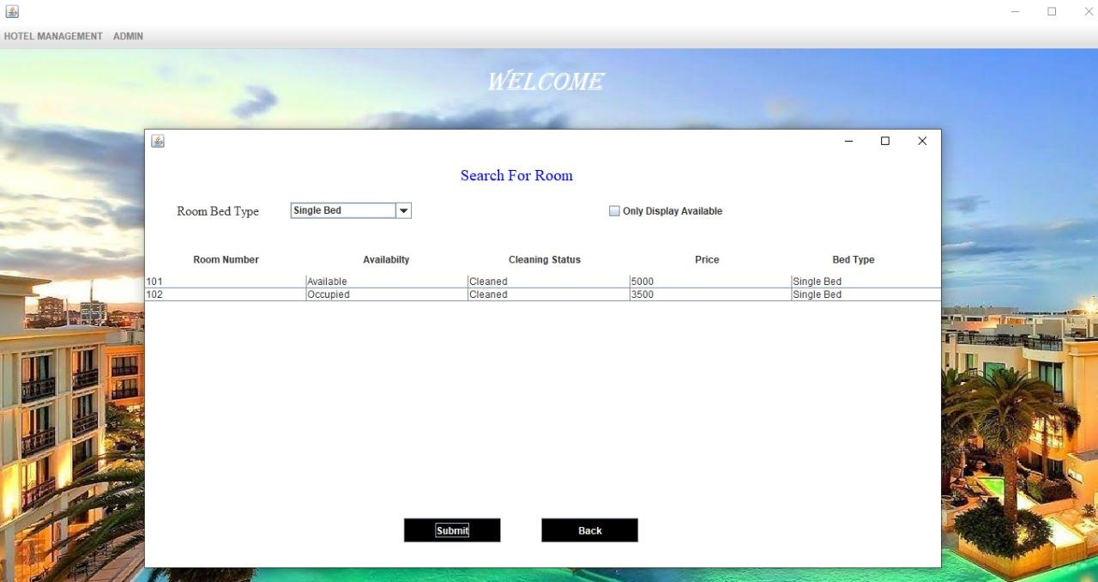
Search For Room

Slide 39
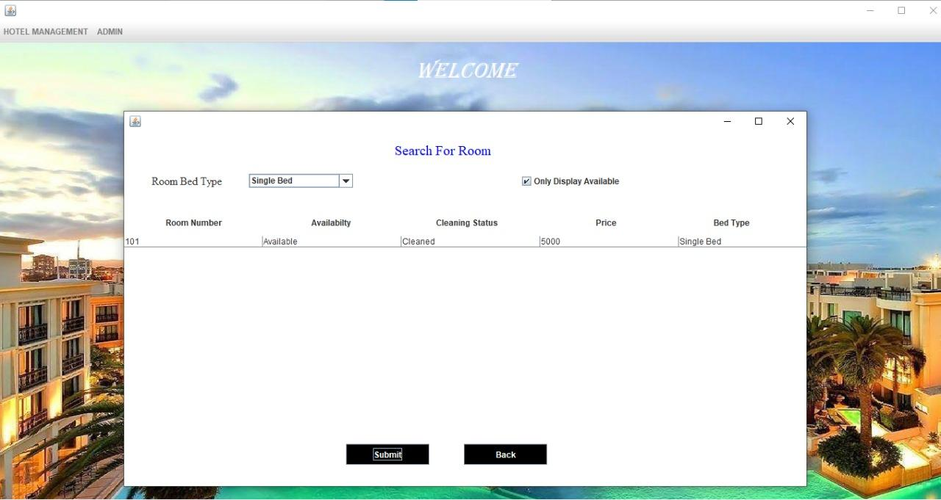
Available Single Beds

Slide 40
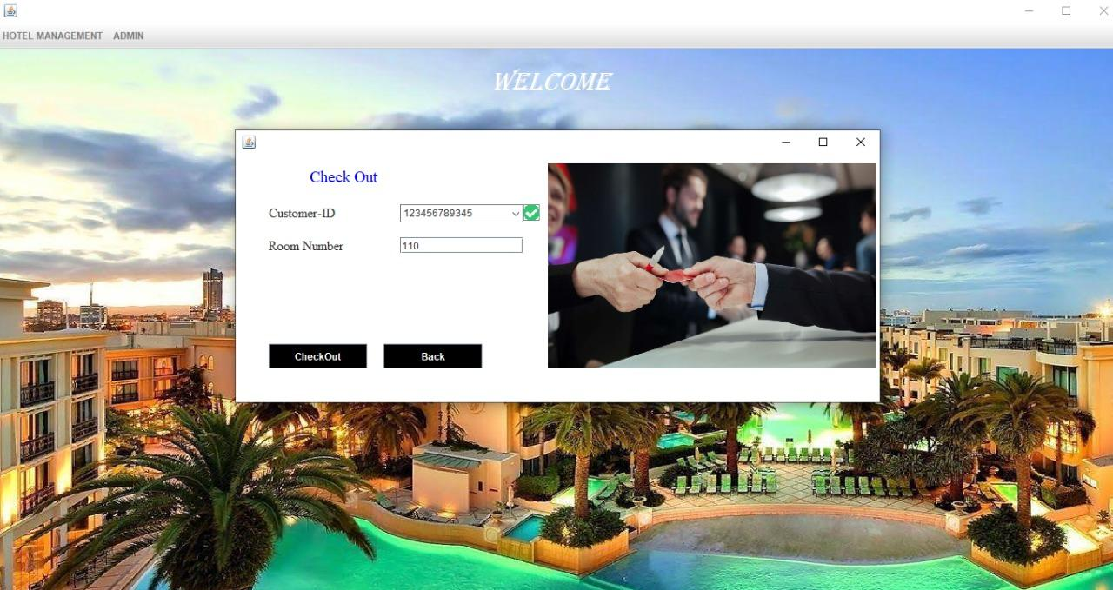
Check Out

Slide 41
Conclusion
In this project we have tried to make a user friendly software. This software can be handled by any person who has a basic idea on how to navigate on computers. We have tried to meet most of the requirements of the present hotel management system including maintaining details of customers, rooms, employees and drivers. We have also added the option to update the details of customers, rooms and employees.

Slide 42
Future Implementation
We would like to implement validation,for phone number,id proofs,password and username.
We would also like to include multiple admin logins ,so that it could be used by many users.

Slide 43
Reference
https://youtube.com/playlist?list=PL5BFcXE899zw2dGJkCKjiLCD-wqCr1HKH

Slide 44


